Slide 1
Introduction to Data Science
John P Dickerson
Lecture #17 – 10/26/2021
CMSC320
Tuesdays & Thursdays
5:00pm – 6:15pm https://cmsc320.github.io/

Slide 2
The Data LifeCycle
Data collection
Data processing
Exploratory analysis
&
Data viz
Analysis, hypothesis testing, & ML
Insight & Policy Decision

Slide 3
Today’s lecture
Introduction to machine learning
How did we actually come up with that linear model from last class?
Basic setup and terminology; linear regression & classification
Thanks to: Zico Kolter (CMU), David Kauchak (Pomona), Nick Mattei (Tulane)
First GIS result for “machine learning”

Slide 4
Recall: Explicit example from the NLP Lectures
Score 𝝍 of an instance x and class y is the sum of the weights for the features in that class:
𝝍_{xy} = Σ θ_{n} f_{n}(x, y)
= θ^{T} f(x, y)
Let’s compute 𝝍_{x1,y=hates_cats} …
𝝍_{x1,y=hates_cats} = θ^{T} f(x₁, y = hates_cats = 0)
= 0*1 + -1*1 + 1*0 + -0.1*1 + 0*0 + 1*0 + -1*0 + 0.5*0 + 1*1
= -1 - 0.1 + 1 = -0.1
1 | I
1 | like
0 | hate
1 | cats
0 | I
0 | like
0 | hate
0 | cats
1 | –
hates_cats
likes_cats
(1)
θ ^{T} =
0 | -1 | 1 | -0.1 | 0 | 1 | -1 | 0.5 | 1
f(x₁, y = 0)

Slide 5
Recall: Explicit example from the NLP Lectures
Saving the boring stuff:
𝝍_{x1,y=hates_cats} = -0.1; 𝝍_{x1,y=likes_cats} = +2.5
𝝍_{x2,y=hates_cats} = +1.9; 𝝍_{x2,y=likes_cats} = +0.5
We want to predict the class of each document:
Document 1: argmax{ 𝝍_{x1,y=hates_cats}, 𝝍_{x1,y=likes_cats} } ????????
Document 2: argmax{ 𝝍_{x2,y=hates_cats}, 𝝍_{x2,y=likes_cats} } ????????
Document 1: I like cats
Document 2: I hate cats

Slide 6
Machine learning
We used a linear model to classify input documents
The model parameters θ were given to us a priori
(John created them by hand.)
Typically, we cannot specify a model by hand.
Supervised machine learning provides a way to automatically infer the predictive model from labeled data.
Training Data
ML Algorithm
Predictions
(x⁽¹⁾, y⁽¹⁾)
(x⁽²⁾, y⁽²⁾)
(x⁽³⁾, y⁽³⁾)
…
Hypothesis function
y^{(i)} = h(x^{(i)})
New example x
y = h(x)

Slide 7
Machine Learning
Arthur Samuel 1959, “… give[s] computers the ability to learn without being explicitly programmed.”
Tom M. Mitchell, “A computer program is said to learn from experience E with respect to some class of tasks T and performance measure P if its performance at tasks in T as measured by P, improves with experience E.”
Major Machine Learning Paradigms:
Supervised Learning: provide labeled examples – machine learns to identify these (classification).
Unsupervised Learning: unlabeled examples – machine learns to differentiate these (clustering).
Reinforcement Learning: provide reward signal – given as feedback to the machine (RL).
[NM]

Slide 8
Learning: Types of Feedback
Supervised Learning.
Learn a function from examples of its inputs and outputs.
E.g., An agent is presented with many camera images and is told to learn which ones contain busses.
Agent learns to map from images to Boolean output 0/1 of bus not present/present.
Learning decision trees is a form of supervised learning.
Unsupervised Learning.
Learn patterns in the input with no output values supplied.
E.g,: Identify communities on the Internet.
Reinforcement Learning.
Learn from reinforcement (occasional rewards).
E.g., An agent learns how to play backgammon or go or chess against itself.
[NM]

Slide 9
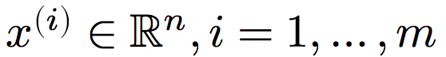
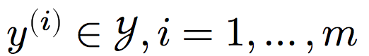
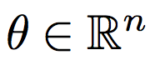
Terminology
Input features:
Outputs:
y^{(i)} ∈ {0, 1} = { hates_cats, likes_cats }
Model parameters:
I | like | hate | cats
1 | 1 | 0 | 1
1 | 0 | 1 | 1
x^{(1)T} =
x^{(2)T} =
θ ^{T} =
0 | -1 | 1 | -0.1 | 0 | 1 | -1 | 0.5 | 1

Slide 10
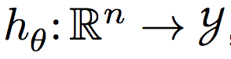
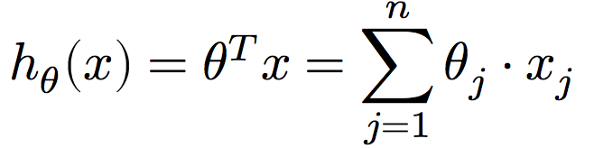
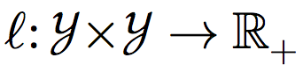
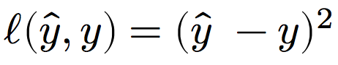
Terminology
Hypothesis function:
E.g., linear classifiers predict outputs using:
Loss function:
Measures difference between a prediction and the true output
E.g., squared loss:
E.g., hinge loss:
Output t = {-1,+1} based on -1 or +1 class label
Classifier score y

Slide 11
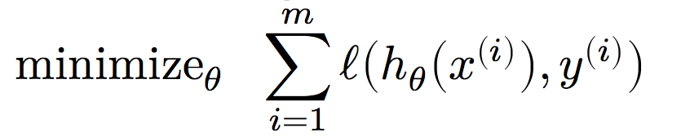
The canonical Machine learning problem
At the end of the day, we want to learn a hypothesis function that predicts the actual outputs well.
And over all your training data*
Choose the parameterization that minimizes loss!
Over all possible parameterizations
Given an hypothesis function and loss function
*Not actually what we want – want it over the world of inputs – will discuss later …

Slide 12
How do I machine learn?
What is the hypothesis function?
Domain knowledge and EDA can help here.
What is the loss function?
We’ve discussed two already: squared and absolute.
How do we solve the optimization problem?
(We’ll cover gradient descent and stochastic gradient descent in class, but if you are interested, take CMSC422!)
First GIS result for “optimization”

Slide 13
Aside: Loss functions

Slide 14
Quick aside about loss functions
Say we’re back to classifying documents into:
hates_cats, translated to label y = -1
likes_cats, translated to label y = +1
We want some parameter vector θ such that:
𝝍_{xy} > 0 if the feature vector x is of class likes_cat; (y = +1)
𝝍_{xy} < 0 if x’s label is y = -1
We want a hyperplane that separates positive examples from negative examples.
Why not use 0/1 loss; that is, the number of wrong answers?

Slide 15
Minimizing 0/1 loss in a single dimension
loss
θ
Each time we change θ such that the example is right (wrong) the loss will increase (decrease)

Slide 16
Minimizing 0/1 loss over all θ
This is NP-hard.
Small changes in any θ can have large changes in the loss (the change isn’t continuous)
There can be many local minima
At any give point, we don’t have much information to direct us towards any minima
Maybe we should consider other loss functions.

Slide 17
Desirable properties
loss
What are some desirable properties of a loss function????????
Continuous so we get a local indication of the direction of minimization
Only one (i.e., global) minimum
θ

Slide 18
Convex functions
“A function is convex if the line segment between any two points on its graph lies above it.”
Formally, given function f and two points x, y:

Slide 19
Surrogate loss functions
For many applications, we really would like to minimize the 0/1 loss
A surrogate loss function is a loss function that is a proxy for the actual loss function (in this case, 0/1) and is hopefully consistent with the 0/1 loss – that is, minimizing the surrogate loss also minimizes the 0/1 loss
We’d like to identify convex surrogate loss functions to make them easier to minimize
Key to a loss function is how it scores the difference between the actual label y and the predicted label y’

Slide 20
Surrogate loss functions
0/1 loss:
Any ideas for surrogate loss functions ?????????? Want: a function that is continuous and convex and is consistent with the 0/1 loss – that is, minimizing the surrogate loss also minimizes the 0/1 loss
Hinge:
Exponential:
Squared:
What do each of these penalize?????????

Slide 21
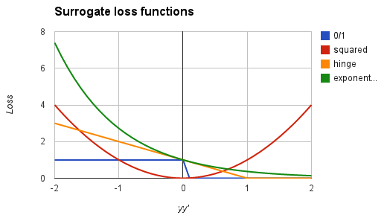
Surrogate loss functions
0/1 loss:
Hinge:
Exponential:
Squared loss:
(Recall: y in {-1, +1})
Notes:
notice, all are convex
all (except hinge) are differentiable

Slide 22
Some ML algorithms
Name | Hypothesis Function | Loss Function | Optimization Approach
Least squares | Linear | Squared | Analytical or GD
Linear regression | Linear | Squared | Analytical or GD
Support Vector Machine (SVM) | Linear, Kernel | Hinge | Analytical or GD
Perceptron | Linear | Perceptron criterion (~Hinge) | Perceptron algorithm, others
Neural Networks | Composed nonlinear | Squared, Hinge, Cross Ent, … | SGD
Decision Trees | Hierarchical halfplanes | Many | Greedy
Naïve Bayes | Linear | Joint probability | #SAT
Follow the white rabbit: https://en.wikipedia.org/wiki/List_of_machine_learning_concepts

Slide 24
Recall: Linear Regression

Slide 25
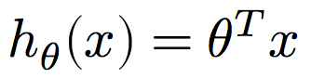
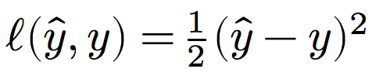
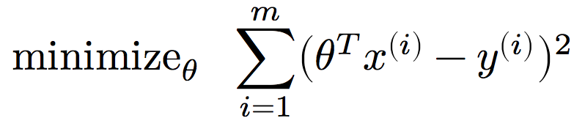
Linear regression as Machine Learning
Let’s consider linear regression that minimizes the sum of squared error, i.e., least squares …
Hypothesis function: ????????
Linear hypothesis function
Loss function: ????????
Squared error loss
Optimization problem: ????????

Slide 26
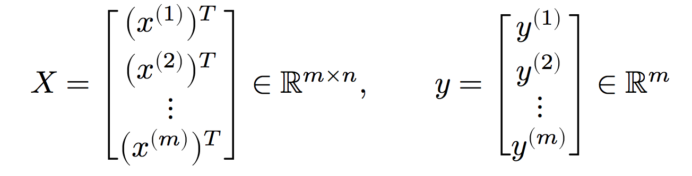
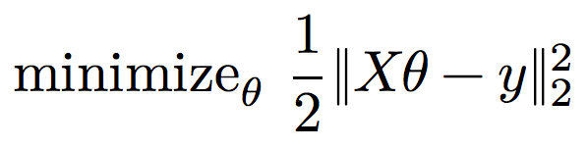
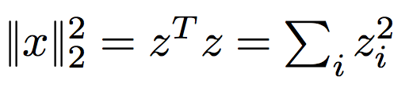
Linear regression as Machine Learning
Rewrite inputs:
Rewrite optimization problem:
Each row is a feature vector paired with a label for a single input
m labeled inputs
n features
*Recall:

Slide 27
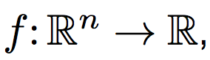
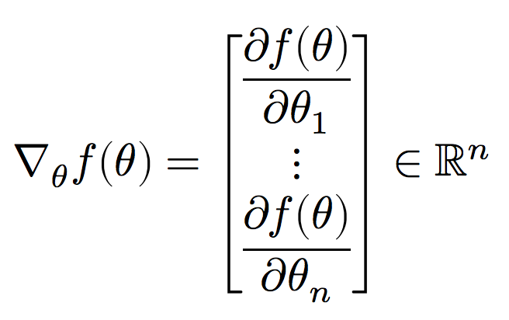
Gradients
In Lecture 10, we showed that the mean is the point that minimizes the residual sum of squares:
Solved minimization by finding point where derivative is zero
(Convex functions like RSS → single global minimum.)
The gradient is the multivariate generalization of a derivative.
For a function the gradient is a vector of all n partial derivatives:

Slide 28
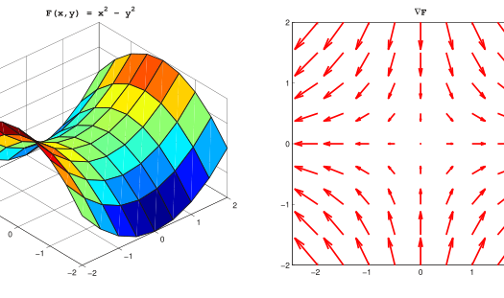
Gradients
Gradient of f(x,y) = xe^{−(x2 + y2)}

Slide 29
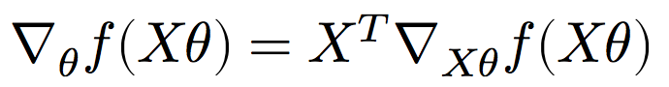
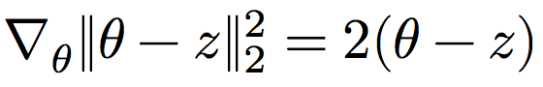
Gradients
Minimizing a multivariate function involves finding a point where the gradient is zero:
Points where the gradient is zero are local minima
If the function is convex, also a global minimum
Let’s solve the least squares problem!
We’ll use the multivariate generalizations of some concepts from MATH141/142 …
Chain rule:
Gradient of squared ℓ² norm:

Slide 30
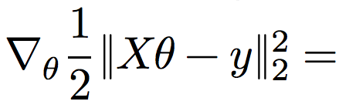
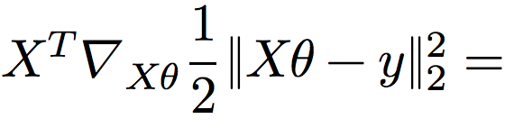
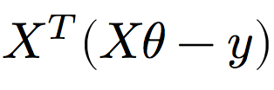
Least squares
Recall the least squares optimization problem:
What is the gradient of the optimization objective ????????
Chain rule:
Gradient of norm:

Slide 31
Least Squares
Recall: points where the gradient equals zero are minima.
So where do we go from here?????????
Solve for model parameters θ

Slide 32
ML in Python
Python has tons of hooks into a variety of machine learning libraries. (Part of why this course is taught in Python!)
Scikit-learn is the most well-known (non-deep-learning) library:
Classification (SVN, K-NN, Random Forests, …)
Regression (SVR, Ridge, Lasso, …)
Clustering (k-Means, spectral, mean-shift, …)
Dimensionality reduction (PCA, matrix factorization, …)
Model selection (grid search, cross validation, …)
Preprocessing (cleaning, EDA, …)
Neural nets and some deep learning, but not the right library for this
Built on the NumPy stack; plays well with Matplotlib.

Slide 33
Least Squares in Python
You don’t need Scikit-learn for OLS …
But let’s say you did want to use it.
# Analytic solution to OLS using Numpy
params = np.linalg.solve(X.T.dot(X), X.T.dot(y))
from sklearn import linear_model
X = [[0,0], [1,1], [2,2]]
Y = [0, 1, 2]
# Solve OLS using Scikit-Learn
reg = linear_model.LinearRegression()
reg.fit(X, Y)
reg.coef_
array([ 0.5, 0.5])

Slide 34
Next Up: (Stochastic) Gradient Descent

Slide 35
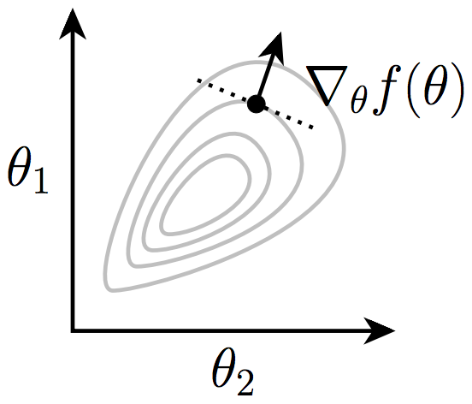
Gradient Descent
We used the gradient as a condition for optimality
It also gives the local direction of steepest increase for a function:
Intuitive idea: take small steps against the gradient.
If there is no increase, gradient is zero = local minimum!
Image from Zico Kolter

Slide 36
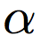
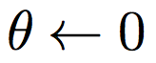
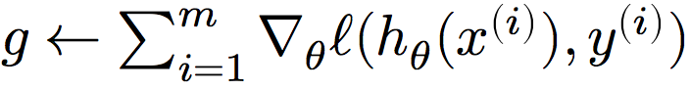
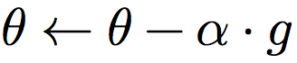
Gradient descent
Algorithm for any* hypothesis function , loss function , step size :
Initialize the parameter vector:
Repeat until satisfied (e.g., exact or approximate convergence):
Compute gradient:
Update parameters:
*must be reasonably well behaved

Slide 37
Gradient Descent
Step-size (\alpha) is an important parameter
Too large → might oscillate around the minima
Too small → can take a long time to converge
If there are no local minima, then the algorithm eventually converges to the optimal solution
Very widely used in Machine Learning

Slide 38
Example
Function: f(x,y) = x² + 2y²
Gradient: ??????????
Let’s take a gradient step from (-2, +1/2):
Step in the direction (+4, -2), scaled by step size
Repeat until no movement
-

Slide 39
[ZK]

Slide 40
[ZK]

Slide 41
[ZK]

Slide 42
[ZK]

Slide 43
[ZK]

Slide 44
[ZK]

Slide 45
[ZK]

Slide 46
[ZK]

Slide 47
[ZK]

Slide 48
[ZK]

Slide 49
[ZK]

Slide 50
[ZK]

Slide 51
[ZK]

Slide 52
[ZK]

Slide 53
[ZK]

Slide 54
[ZK]

Slide 55
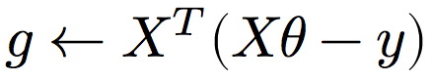
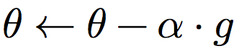
In General: Gradient Descent for OLS
Algorithm for linear hypothesis function and squared error loss function (combined to , like before):
Initialize the parameter vector:
Repeat until satisfied:
Compute gradient:
Update parameters:

Slide 56
Gradient descent in Pure(-ish) python
# Training data (X, y), T time steps, alpha step
def grad_descent(X, y, T, alpha):
m, n = X.shape # m = #examples, n = #features
theta = np.zeros(n) # initialize parameters
f = np.zeros(T) # track loss over time
for i in range(T):
# loss for current parameter vector theta
f[i] = 0.5*np.linalg.norm(X.dot(theta) – y)**2
# compute steepest ascent at f(theta)
g = X.T.dot(X.dot(theta) – y)
# step down the gradient
theta = theta – alpha*g
return theta, f
Implicitly using squared loss and linear hypothesis function above; drop in your favorite gradient for kicks!

Slide 57
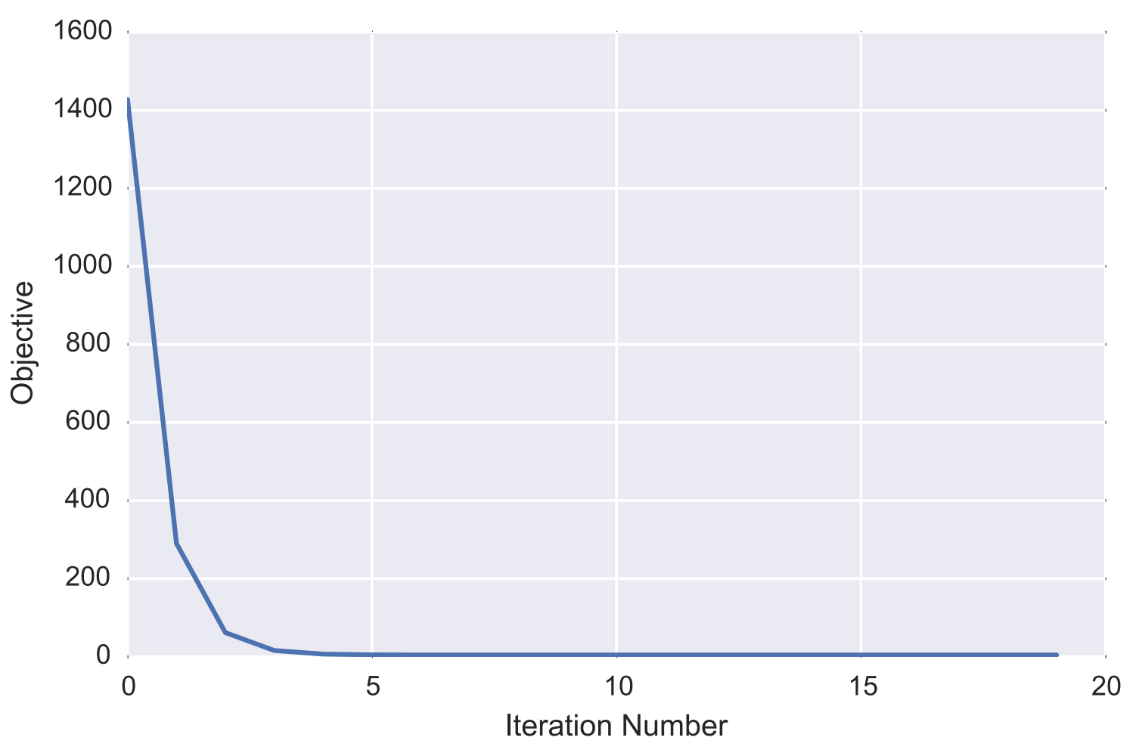
Plotting Loss over time
Why ????????
Image from Zico Kolter

Slide 58
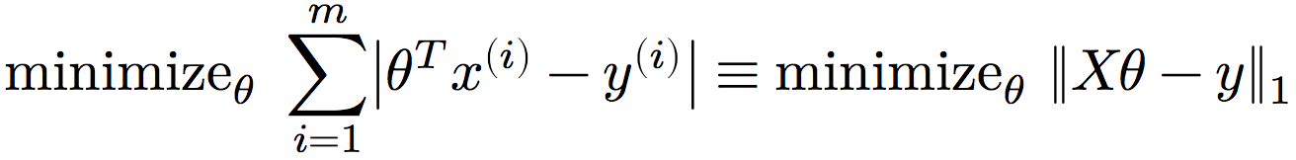
Iterative vs analytic solutions
But we already had an analytic solution! What gives?
Recall: last class we discuss 0/1 loss, and using convex surrogate loss functions for tractability
One such function, the absolute error loss function, leads to:
Problems ????????
Not differentiable! But subgradients?
No closed form!
So you must use iterative method

Slide 59
Least Absolute Deviations
Can solve this using gradient descent and the gradient:
Simple to change in our Python code:
for i in range(T):
# loss for current parameter vector theta
f[i] = np.linalg.norm(X.dot(theta) – y, 1)
# compute steepest ascent at f(theta)
g = X.T.dot( np.sign(X.dot(theta) – y) )
# step down the gradient
theta = theta – alpha*g
return theta, f

Slide 60
Batch vs Stochastic Gradient Descent
Batch: Compute a single gradient (vector) for the entire dataset (as we did so far)
Incremental/Stochastic:
Do one training sample at a time, i.e., update parameters for every sample separately
Much faster in general, with more pathological cases
From: Andrew Ng, CS229 Lecture Notes

